Slide 1
Module 1
Introduction to Data Warehousing
Notes:
The 20767C-MIA-SQL virtual machine used in the lab for this module includes several software services that can take a while to start. For the best experience, have students start the 20767C-MIA-DC and 20767C-MIA-SQL virtual machines at the beginning of the module so that the services have time to start before they begin the lab.
20767C
1: Introduction to Data Warehousing

Slide 2
Module Overview
Overview of Data Warehousing Considerations for a Data Warehouse Solution
Notes:
20767C
1: Introduction to Data Warehousing

Slide 3
Lesson 1: Overview of Data Warehousing
The Business Problem What Is a Data Warehouse? Data Warehouse Architectures Components of a Data Warehousing Solution Data Warehousing Projects Data Warehousing Project Roles SQL Server As a Data Warehousing Platform
Notes:
20767C
1: Introduction to Data Warehousing

Slide 4
The Business Problem
A successful business needs to be able to adapt— the following problems make that difficult:
Business data is spread across many systems
Data can be inconsistent, duplicated, and contradictory
Fundamental questions can’t be easily answered
Notes:
Emphasize that the drivers for a data warehousing solution are typically business-related rather than technical.
Ask students about the various applications and data stores in their organizations. How easy or difficult is it for students to collate data to create an overall, business-wide view of the key measures that drive strategic business decision-making?
20767C
1: Introduction to Data Warehousing

Slide 5
What Is a Data Warehouse?
A centralized store of business data for reporting and analysis that typically:
Contains large volumes of historical data
Is optimized for querying, as opposed to inserting or updating data
Is incrementally loaded with new business data at regular intervals
Provides the basis for enterprise BI solutions
Notes:
Explain that this course uses a fairly generic definition for a data warehouse. There are many very specific definitions in use throughout the data warehousing industry; students might be aware of some of the more common schools of thought on database design, including those of Bill Inmon and Ralph Kimball. This course does not advocate one approach over another, although the lab solutions and data warehouse schema design discussed here are more in line with a Kimball-based approach than any other.
20767C
1: Introduction to Data Warehousing

Slide 6

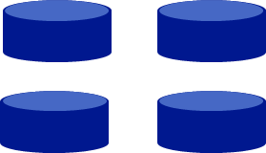
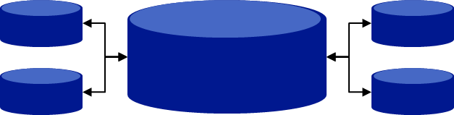
Data Warehouse Architectures
Central Data Warehouse
Departmental Data Marts
Hub-and-Spoke
Notes:
Encourage students to consider the benefits of each architecture discussed in this topic:
A centralized data warehouse provides a single source for all business analysis, reporting, and decision-making. However, designing and building such a comprehensive solution presents some significant challenges in devising a single schema that meets the needs of every business unit, and can result in huge volumes of data being transferred into the data warehouse from various source systems.
A departmental data warehouse is more focused on the needs of a specific set of users, but might not hold a complete business-wide view of all key data. You might end up with multiple small data marts, each dealing with a discrete part of the business. These will improve reporting, analysis, and decision-making within individual departments but will not necessarily make it easier to get an overall view of the business.
In some ways, a hub-and-spoke architecture offers the best aspects of the centralized data warehouse and departmental data mart approaches. However, it can be difficult to design and build—and synchronizing data between the hub and various spokes can present its own challenges.
For a more detailed discussion about these various architectures, see Hub-And-Spoke: Building an EDW with SQL Server and Strategies of Implementation at:
Building an EDW with SQL Server
http://go.microsoft.com/fwlink/?LinkID=248853
20767C
1: Introduction to Data Warehousing

Slide 7
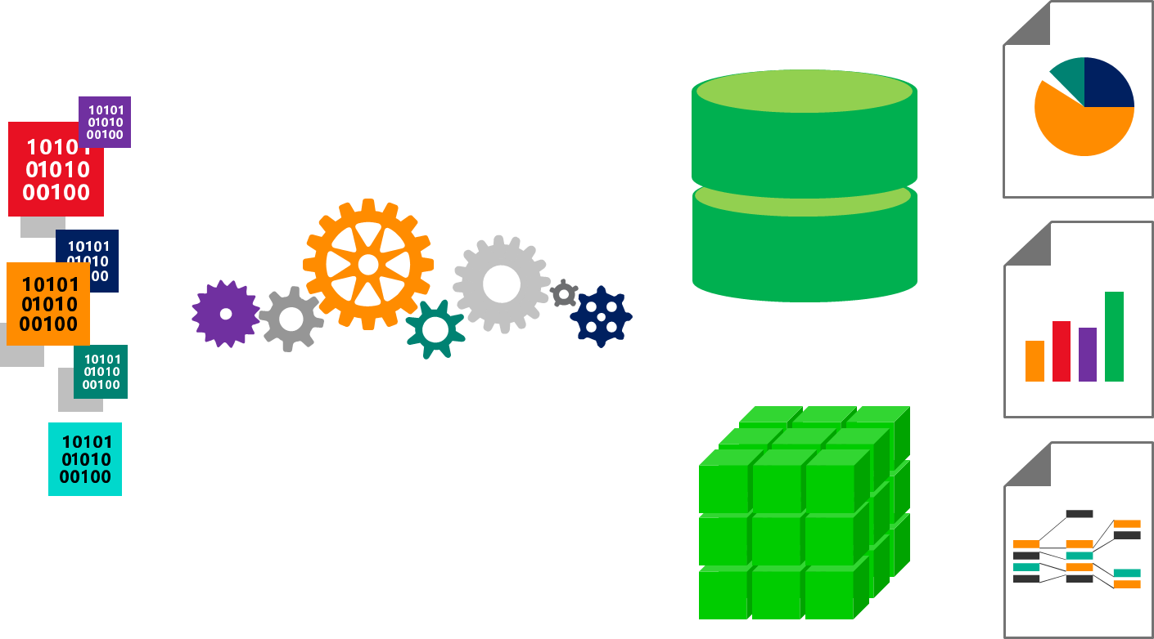
Components of a Data Warehousing Solution
Data Warehouse
Data Sources
ETL and
Data Cleansing
MDM
Data Models
Reporting and
Analysis
Notes:
Note that not all data warehousing solutions include every component shown on the slide. However, each component has an important part to play in the implementation of a data warehousing solution, and will be considered later in this course.
20767C
1: Introduction to Data Warehousing

Slide 8
Data Warehousing Projects
What are the business questions that need to be answered?
What data is required to answer them?
Where is this data and how easy is it to obtain?
Knowing the above, assess the importance of each question against the ability to answer it from existing data
Notes:
For large enterprise-level projects, an incremental approach can be effective:
Break down the project into multiple subprojects.
Each subproject deals with a particular subject area in the data warehouse.
Emphasize that a successful data warehousing project requires significant effort in gathering business requirements, and this can only be achieved with executive sponsorship, senior management support, and broad “buy-in” from business units.
20767C
1: Introduction to Data Warehousing

Slide 9

Data Warehousing Project Roles
Project Manager | Solution Architect | Data Modeler | Database Administrator | Infrastructure Specialist
ETL Developer | Business Users | Business Analyst | Testers | Data Stewards
Notes:
Note that the role names may differ from one organization to another, but the tasks that each perform are essential to a successful data warehousing project.
There is not necessarily a one-to-one correspondence between roles and individuals. All the following role assignments are possible:
A single individual performs each role.
A single individual performs multiple roles.
Multiple individuals share a single role.
20767C
1: Introduction to Data Warehousing

Slide 10
SQL Server As a Data Warehousing Platform
Core Data Warehousing
Database Engine
Integration Services
Master Data Services
Data Quality Services
Business Intelligence
Analysis Services
Reporting Services
Notes:
Point out that the rest of this course is focused on the core data warehousing technologies.
Sequencing Activity
Put the following steps in a data warehouse project in order by numbering each to indicate the correct order.
Steps
(1)Work with business stakeholders to identify key questions.
(2)Identify the data that might be able to answer the identified questions.
(3)Identify where data can be sourced.
(4)Prioritize questions that need answers.
(5)Identify the people or groups who require access to the produced data.
20767C
1: Introduction to Data Warehousing

Slide 11
Lesson 2: Considerations for a Data Warehouse Solution
Data Warehouse Database and Storage Columnstore Indexes Data Sources Extract, Transform, and Load Processes Data Quality and Master Data Management
Notes:
20767C
1: Introduction to Data Warehousing

Slide 12
Data Warehouse Database and Storage
Database Schema
Hardware
High Availability and Disaster Recovery
Security
Notes:
Remind students that data warehouse schema design and infrastructure are covered later in this course.
20767C
1: Introduction to Data Warehousing

Slide 13
Columnstore Indexes
Row-based index
Can be clustered and nonclustered Improve performance on row level queries, inserts and updates Best used in OLTP databases All data in a row is processed
Column-based index
Can be clustered and nonclustered Improve performance on queries that scan a table, aggregation and analytical queries Best used in data warehouses Only columns needed are processed
A clustered columnstore index can be combined with multiple nonclustered row indexes to have the benefits of both types
Notes:
Columnstore indexes are discussed in further detail in Module 4: Columnstore Indexes.
20767C
1: Introduction to Data Warehousing

Slide 14
Data Sources
Data Source Connection Types
Credentials and Permissions
Data Formats
Data Acquisition Windows
Notes:
20767C
1: Introduction to Data Warehousing

Slide 15
Extract, Transform, and Load Processes
Staging:
What data must be staged?
Staging data format
Required transformations:
Transformations during extraction versus data flow transformations
Incremental ETL:
Identifying data changes for extraction
Inserting or updating when loading
Notes:
Remind students that incremental ETL is covered in more depth in Module 9: Implementing an Incremental ETL Process.
20767C
1: Introduction to Data Warehousing

Slide 16
Data Quality and Master Data Management
Data quality
Cleansing data:
Validating data values
Ensuring data consistency
Identifying missing values
Deduplicating data
Master data management
Ensuring consistent business entity definitions across multiple systems
Applying business rules to ensure data validity
Notes:
Both subjects will be covered in more detail in later modules.
Categorize Activity
Which of the following are optimal places to perform data transformations in an ETL solution?
Optimal solution
(1)Perform simple transformations in the query that is used to extract the data.
(2)Implement transformations in a data flow task, within an ETL process, when complex row-by-row processing is required.
(3)Perform complex transformations in a staging database, where it is possible to combine data from multiple sources.
Suboptimal solution
(1)All the data transformations should be completed by the derived reports.
(2)There is no optimal place to perform data transformations.
20767C
1: Introduction to Data Warehousing

Slide 17
Lab: Exploring a Data Warehousing Solution
Exercise 1: Exploring Data Sources Exercise 2: Exploring an ETL Process Exercise 3: Exploring a Data Warehouse
Logon Information
Virtual Machine: 20767C-MIA-SQL
User name: ADVENTUREWORKS\Student
Password: Pa55w.rd
Estimated Time: 30 minutes
Notes:
Point out that the lab instructions are deliberately designed to be high level so that students need to think carefully about what they are trying to accomplish and work out how best to proceed. Encourage students to read the scenario information carefully and collaborate with each other to meet the scenario requirements. Remind students that, if they find a particular task or exercise too challenging, they can find step-by-step instructions in the lab answer key.
Point out that, like all other labs in this course, students must start by running a setup script to prepare the lab environment.
Exercise 1: Exploring Data Sources
Adventure Works uses various software applications to manage different aspects of the business, and each has its own data store. Specifically, these are:
Internet sales processed through an e-commerce web application.
Reseller sales processed by sales representatives, who use a specific application. Sales employee details are stored in a separate human resources system.
Reseller payments are processed by an accounting application.
Products are managed in a product catalog and inventory system.
This distribution of data has made it difficult for users to answer key questions about the overall performance of the business.
In this exercise, you will examine some of the Adventure Works data sources that will be used in the data warehousing solution.
Exercise 2: Exploring an ETL Process
Now that you are familiar with the data sources in the Adventure Works data warehousing solution, you will examine the ETL process used to stage the data, and then load it into the data warehouse.
Adventure Works uses a solution based on SQL Server Integration Services to perform this ETL process.
Exercise 3: Exploring a Data Warehouse
Now that you have explored the ETL process that is used to populate the Adventure Works data warehouse, you can explore the data warehouse to see how business users can view key information.
20767C
1: Introduction to Data Warehousing

Slide 18
Lab Scenario
The labs in this course are based on a fictional company called Adventure Works Cycles that manufactures and sells cycles and cycling accessories to customers all over the world. Adventure Works sells direct to customers through an e-commerce website and also through an international network of resellers.
Throughout this course, you will develop a data warehousing solution for Adventure Works Cycles, including: a data warehouse; an ETL process to extract data from source systems and populate the data warehouse; a data quality solution; and a master data management solution.
Notes:
20767C
1: Introduction to Data Warehousing

Slide 19
Lab Scenario (Continued)
The lab for this module provides a high level overview of the solution that you will create in later labs. You can use this lab to become familiar with the various elements of the data warehousing solution that you will learn to build in later modules.
Notes:
20767C
1: Introduction to Data Warehousing

Slide 20
Lab Review
After completing this lab, you are now able to:
Describe the data sources in the Adventure Works data warehousing scenario.
Describe the ETL process in the Adventure Works data warehousing scenario.
Describe the data warehouse in the Adventure Works data warehousing scenario.
Notes:
20767C
1: Introduction to Data Warehousing

Slide 21
Module Review and Takeaways
Review Question(s)
Notes:
Review Question(s)
Question
Why might you consider including a staging area in your ETL solution?
Answer
You should consider using a staging area if you need to extract data from multiple data sources that have differing acquisition windows, or if you need to perform data transformations, validation, cleansing, or deduplication before loading the data into the data warehouse.
Question
Which project role would be best assigned to a business user?
( )Option 1: Solution Architect
( )Option 2: Data Modeler
( )Option 3: Data Steward
( )Option 4: Tester
Answer
(√) Option 3: Data Steward
20767C
1: Introduction to Data Warehousing

